Slide 1
The Cell Cycle
&
Cell Division

Slide 2
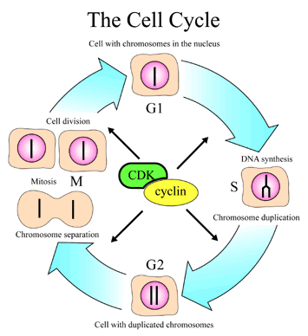
The Cell Cycle
http://www.nobel.se/medicine/laureates/2001/press.html

Slide 3
Animated Cycle
http://www.cellsalive.com/cell_cycle.htm

Slide 4
MITOSIS

Slide 5
Mitosis
The part of cell division which results in two identical daughter cells from a single parent cell.

Slide 6
Cell Division can be divided into stages
Interphase
Prophase
Metaphase
Anaphase
Telophase
Cytokinesis

Slide 7
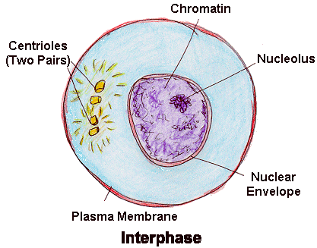
Interphase
The cell prepares for division
Animal & Plant Cell
  DNA replicated (copied)
  Makes new organelles (synthesis)
  Cell increases in size (growth)

Slide 8
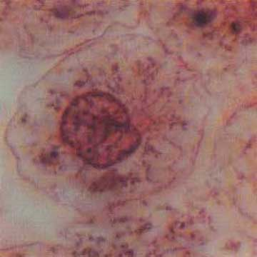
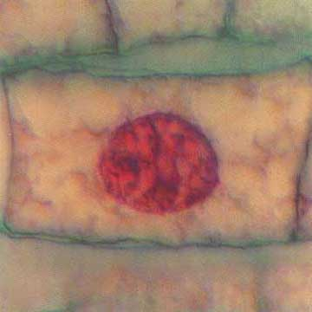
Interphase
Animal Cell
Plant Cell
Photographs from: http://www.bioweb.uncc.edu/biol1110/Stages.htm

Slide 9
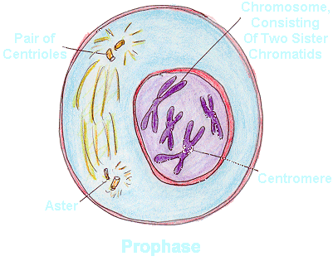
Prophase
The cell prepares for nuclear division
Animal & Plant Cell
  Chromosomes appear
  Centrioles separate & spindles form
  Nuclear envelope disappears
  LONGEST phase in mitosis

Slide 10
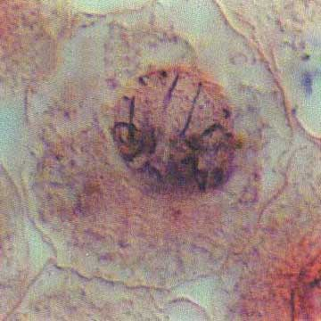
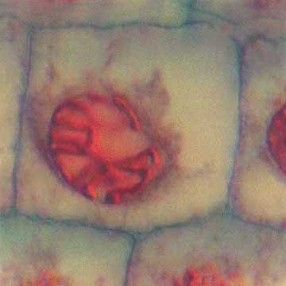
Prophase
Animal Cell
Plant Cell
Photographs from: http://www.bioweb.uncc.edu/biol1110/Stages.htm

Slide 11
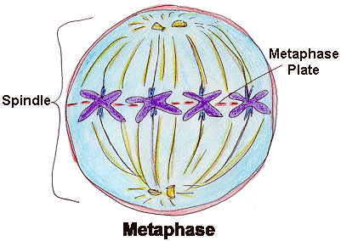
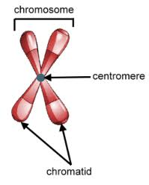
Metaphase: The cell prepares chromosomes for division
Animal & Plant Cell
  Chromosomes line up at the middle of the cell
  Spindle fibers attach to chromosomes at the centromere
  SHORTEST phase of mitosis

Slide 12
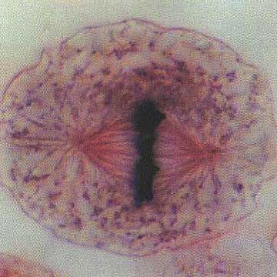
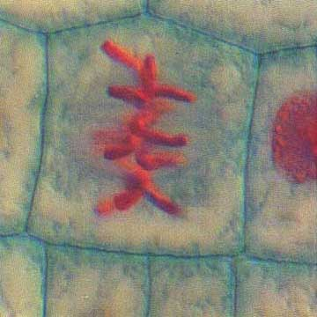
Metaphase
Animal Cell
Plant Cell
Photographs from: http://www.bioweb.uncc.edu/biol1110/Stages.htm

Slide 13
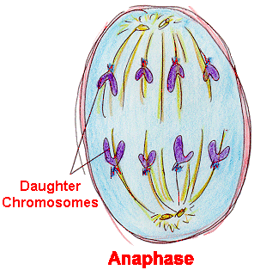
Anaphase
The chromosomes divide
Animal & Plant Cell
  Spindle fibers pull chromosomes apart
  ½ of each chromosome (called chromatid) moves to poles of cells

Slide 14
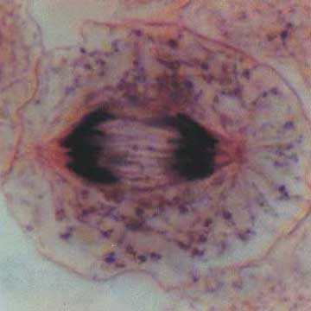
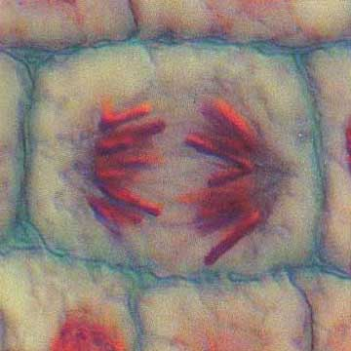
Anaphase
Animal Cell
Plant Cell
Photographs from: http://www.bioweb.uncc.edu/biol1110/Stages.htm

Slide 15
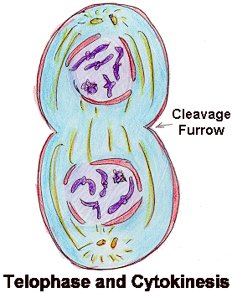
Telophase
The cytoplasm divides
Animal Cell
  DNA uncoils & appears as chromatin again
  2 nuclei form
  Cell membrane pinches in to form the 2 new daughter cells
Plant Cell
  DNA uncoils & appears as chromatin again
  2 nuclei form
  New cell wall forms between two nuclei to form the 2 new daughter cells

Slide 16
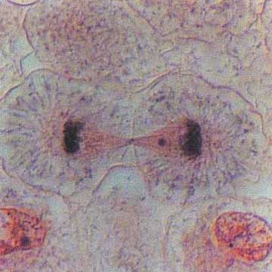
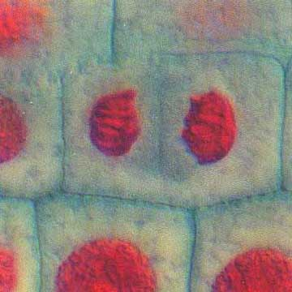
Telophase
Animal Cell
Plant Cell
Photographs from: http://www.bioweb.uncc.edu/biol1110/Stages.htm

Slide 17
Mitosis Animation
http://www.cellsalive.com/mitosis.htm

Slide 18
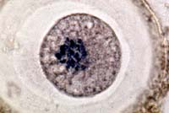
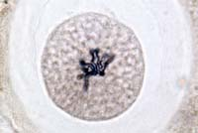
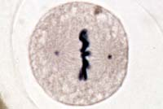
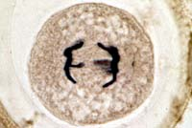
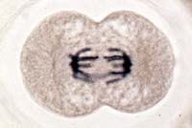
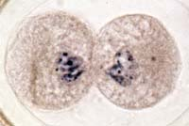
Animal Mitosis -- Review
Interphase | Prophase
Metaphase | Anaphase
Telophase | Interphase

Slide 19
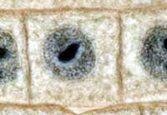
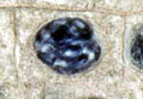
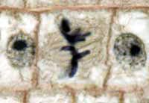
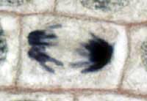
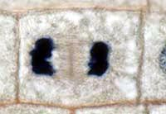
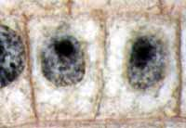
Plant Mitosis -- Review
Interphase | Prophase
Metaphase | Anaphase
Telophase | Interphase

Slide 20
Cytokinesis
Division of the cytoplasm- creating 2 new cells
Begins in telophase
In animals- look for cleavage furrow
In plants- look for a cell plate
Review

